Slide 1
Battery Model and Characterization
Aug 15, 2023

Slide 2
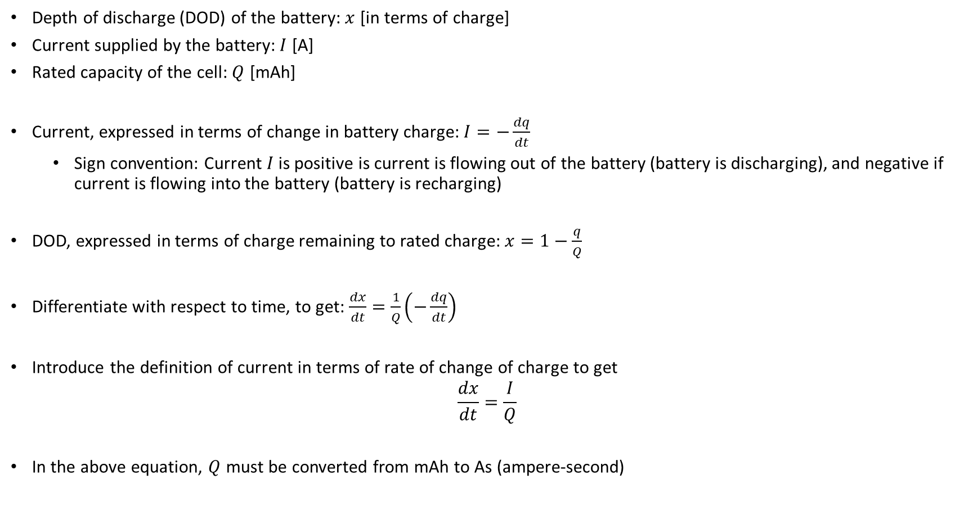
Relating battery depth of discharge, current, and capacity
Depth of discharge (DOD) of the battery: $x$ [in terms of charge]
Current supplied by the battery: $I$ [A]
Rated capacity of the cell: $Q$ [mAh]
Current, expressed in terms of change in battery charge: $I=−\frac{dq}{dt}$
Sign convention: Current $I$ is positive is current is flowing out of the battery (battery is discharging), and negative if current is flowing into the battery (battery is recharging)
DOD, expressed in terms of charge remaining to rated charge: $x=1−\frac{q}{Q}$
Differentiate with respect to time, to get: $\frac{dx}{dt}=\frac{1}{Q}\left(−\frac{dq}{dt}\right)$
Introduce the definition of current in terms of rate of change of charge to get
$$\frac{dx}{dt}=\frac{I}{Q}$$
In the above equation, $Q$ must be converted from mAh to As (ampere-second)

Slide 3
1. Preconditioning Test
Goal: Remove possible passivation in the cell during the time interval between manufacture and first test. Verify that the cell shows stable charge capacity.
Steps
Let the battery sit in the test area for one hour to reach thermal equilibrium.
Charge the battery fully using a constant current (CC) – constant voltage (CV) charging profile. Charging stops when CV current reaches a predefined threshold.
Let the battery sit in the test area for one hour to reach thermal equilibrium.
Discharge the battery completely using a (TBD) current. Discharge is considered complete once voltage reaches the minimum (TBD) pack voltage.
Let the battery sit in the test area for one hour to reach thermal equilibrium.
From the data for each charge and discharge cycle, do “coulomb counting” to compute battery capacity in ampere-hour (Ah). If a current of “x” A discharges the battery in “y” hours, then the computed capacity is “xy” Ah.
Repeat steps 2-6 four more times, or until stable capacity (within 3% of initial measured capacity) is obtained from two consecutive charge/discharge tests
Store, D.I., “Lifetime Models for Lithium-ion Batteries used in Virtual Power Plant Applications,” PhD. Thesis, Aalborg University, 2014

Slide 4
2. Capacity Test
Goal: Determine capacity of battery and its variation with respect to operating temperature and load current.
Steps
Let the battery sit in the test area at the test temperature for one hour to reach thermal equilibrium.
Charge the battery fully using a constant current (CC) – constant voltage (CV) charging profile, using (TBD1) current. Charging stops when CV current reaches a predefined threshold.
Let the battery sit in the test area at the test temperature for one hour to reach thermal equilibrium.
Discharge the battery completely using (TBD1) current. Discharge is considered complete once voltage reaches the minimum (TBD) pack voltage.
Let the battery sit in the test area at the test temperature for one hour to reach thermal equilibrium.
From the data for each charge and discharge cycle, do “coulomb counting” to compute battery capacity in ampere-hour (Ah). If a current of “x” A discharges the battery in “y” hours, then the computed capacity is “xy” Ah.
Repeat steps 2-6 with currents (TBD2), (TBD3), (TBD4),…
Repeat steps 2-7 at temperatures (Temp2), (Temp3), (Temp4),…
Inspect collected data to see if there is any significant variation of capacity with respect to load current at a given temperature.
Store, D.I., “Lifetime Models for Lithium-ion Batteries used in Virtual Power Plant Applications,” PhD. Thesis, Aalborg University, 2014

Slide 5
3. Open Circuit Voltage vs. State of Charge Test
Goal: Determine the OCV versus SOC (or DOD) characteristic of the battery as a function of temperature.
Steps
Let the battery sit in the test area at the test temperature for one hour to reach thermal equilibrium.
Fully discharge the battery using (TBD) current. Discharge is considered complete once voltage reaches threshold.
Let the battery sit in the test area at the test temperature for one hour to reach thermal equilibrium.
Charge the battery using (TBD) current for 5% SOC.
Let the battery sit in the test area at the test temperature for one hour to reach thermal equilibrium. Measure the voltage after one hour. This is the OCV for this particular SOC.
Repeat steps 4-5 until the battery is fully charged.
Discharge the battery using (TBD) current for 5% SOC.
Let the battery sit in the test area at the test temperature for one hour to reach thermal equilibrium. Measure the voltage after one hour. This is the OCV for this particular SOC.
Repeat steps 7-8 until the battery is fully discharged.
Repeat steps 1-9 at other test temperatures to capture the effect of temperature on OCV vs. SOC characteristic.
Store, D.I., “Lifetime Models for Lithium-ion Batteries used in Virtual Power Plant Applications,” PhD. Thesis, Aalborg University, 2014

Slide 6
4. Internal Resistance vs. State of Charge Test
Goal: Determine the OCV versus SOC (or DOD) characteristic of the battery as a function of temperature.
Steps
Let the battery sit in the test area at the test temperature for one hour to reach thermal equilibrium.
Fully discharge the battery using (TBD) current. Discharge is considered complete once voltage reaches threshold.
Let the battery sit in the test area at the test temperature for one hour to reach thermal equilibrium.
Charge the battery using (TBD) current for 5% SOC.
Let the battery sit in the test area at the test temperature for one hour to reach thermal equilibrium.
Apply the pulse profile (see following slide) to gather data for computing internal resistance.
Repeat steps 4 to 6 for all SOCs (in increments of 5%) until the battery is fully charged.
Repeat steps 1-7 at other test temperatures to capture the effect of temperature on resistance vs. SOC.
Store, D.I., “Lifetime Models for Lithium-ion Batteries used in Virtual Power Plant Applications,” PhD. Thesis, Aalborg University, 2014

Slide 7
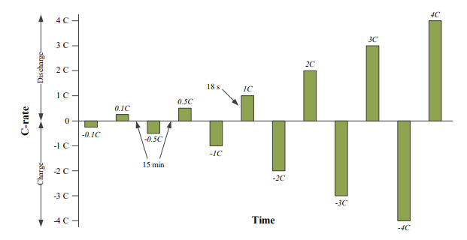
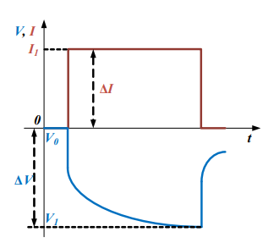

4. Internal Resistance vs. State of Charge Test
The dynamic (transient) part of the response is captured using the R-C paid in the battery equivalent circuit model
Not accounting for this is actually more conservative from the standpoint of battery sizing.
Current pulses last for 18 seconds
Time between pulses is 15 minutes
Store, D.I., “Lifetime Models for Lithium-ion Batteries used in Virtual Power Plant Applications,” PhD. Thesis, Aalborg University, 2014

Slide 8
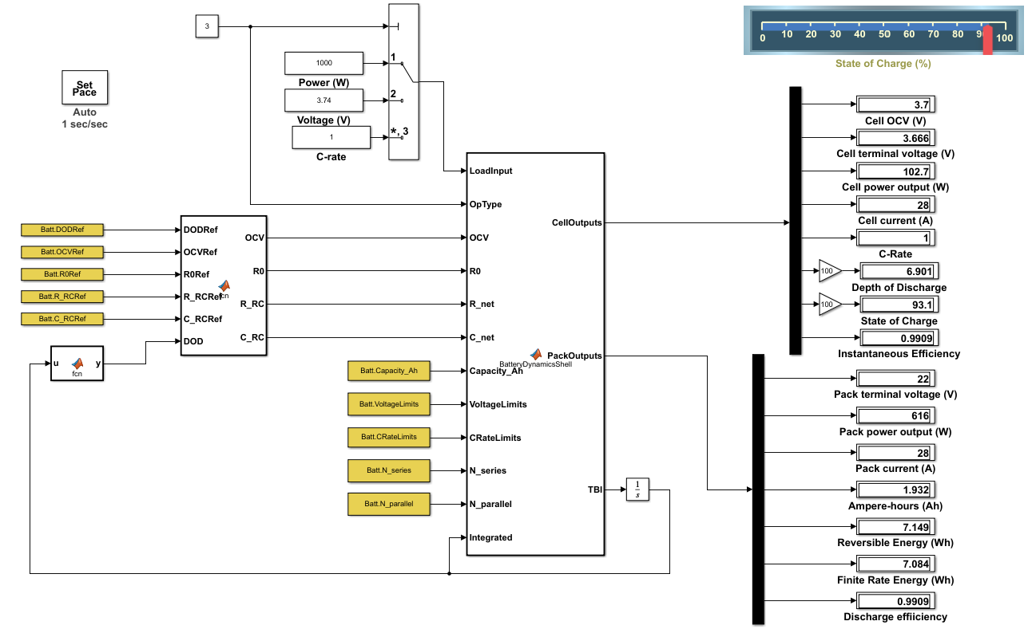
Battery Equivalent Circuit Simulink Model
Comment in to run in real-time. Comment out to run as fast as your PC allows.
Loads can be specified in terms of power, voltage, or current (C-rate)
Parameters in yellow are to be identified from charge/discharge tests or from battery specs
Run BatterySetup.m script prior to running Simulink model. It loads the necessary battery parameters into the workspace.

Slide 9
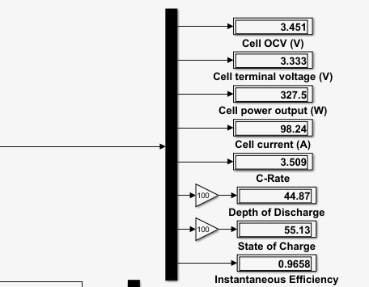
Battery Model Outputs – Cell Level
Open Circuit Voltage (OCV): This is the voltage that would be measured at the terminals when no power is being drawn. The OCV reduces with state of charge
Cell terminal voltage (V): This is the voltage measured at the terminals when power is being drawn. The higher the power draw, the larger the terminal voltage drops relative to the OCV.
Cell power output (W): self-explanatory, positive if cell is discharging
Cell current output (A): self-explanatory, positive if cell is discharging
Inverse of time in hours to discharge battery completely at constant current. A C-rate of 1 means the battery is discharged fully in 1 hour. C-rate of 10 means that the battery is fully drained in 1/10 hour, i.e., 6 minutes
Depth of Discharge (DOD): Measure of how much charge has been discharged, expressed as a percentage of battery rated charge capacity.
Depth of Discharge (DOD): Measure of how much charge has been discharged, expressed as a percentage of battery rated charge capacity.
The efficiency is 1.00 (i.e., 100%) if the battery is being discharged/charged with infinitesimally small current. The higher the current, the lower the efficiency, as energy is lost as heat through the internal resistance of the battery.

Slide 10
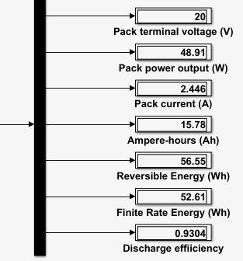
Battery Model Outputs – Pack Level
Pack terminal voltage (V): This is the voltage measured at the terminals when power is being drawn. The higher the power draw, the lower the terminal voltage
Pack power output (W): self-explanatory, positive if cell is discharging
Pack current output (A): self-explanatory, positive if cell is discharging
“Coulomb counting”, a measure of the charge drawn from or supplied to the battery during discharging and charging, respectively. 1 Ampere = 1 Coulomb / second, and 1 Ah = 3600 Coulomb
The theoretical maximum energy that the battery could supply if discharged infinitely slowly (i.e., with no energy losses)
The actual energy obtained from the battery when it is discharged at a finite rate, which is associated with internal losses. Always lower than reversible energy
A measure of the efficiency of a finite rate discharge. Measured as the ratio of the actual energy extracted to the theoretical reversible energy obtained from an infinitely slow discharge (with no losses)

Slide 11
Reversible Energy, Finite Rate Energy, and Discharge Efficiency
Open circuit voltage
Open circuit voltage
Terminal
Cell Voltage
Reversible Energy
Cell Voltage
Voltage
Initial DOD
Initial DOD
Finite Rate Energy
Final DOD
Final DOD
Depth of discharge
Depth of discharge
The discharge efficiency between the initial and final DOD is the ratio of the finite rate energy to the reversible energy

Slide 12
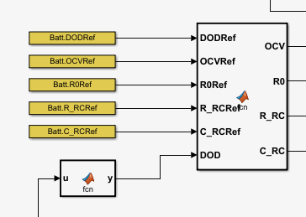
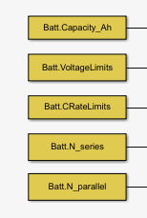
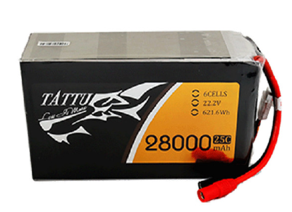
Battery Parameters Input to the Battery Model
Reference DOD values for lookup table, [0, 10, 20, …., 100]
Notes: Some simple calculations
28000 mAh = 28 Ah
The 1C current for this pack is 28A. It will theoretically drain the battery in 1 hour.
The 25C current limit means 25 x 28 = 700A. This will drain the battery in 1/25 hour = 2.4 min
Battery OCV as a function of DOD
Battery internal resistance as a function of DOD
Resistor-capacitor pair used for modeling dynamic response. Can be conservatively ignored for sizing purposes
Tattu 28000mAh 22.2V 25C 6S1P Lipo Battery Pack

Slide 13
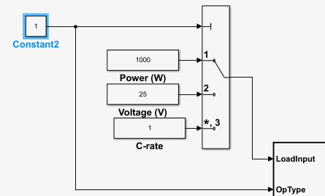
Specifying the battery load in the Simulink Model
Specify load type. Set = 1 to specify load power. Set = 2 to specify terminal voltage. Set = 3 to specify current (in terms of C-rate)
Set battery power in watt (W). Positive when power flows out of battery (discharge). Set to negative value to recharge the battery.
Set terminal voltage (V). Set lower than *pack* (not cell) open circuit voltage to discharge the battery. Set higher than pack OCV to recharge the battery.
Specify battery current in terms of C-rate. Positive when current flows out of the battery (discharge). Set to negative value to recharge the battery.
Note: This battery model will be integrated into the xVy MADCASP simulation model. Since the power consumption of the propellers and tailfan are known, the battery model will be evaluated in Mode 1 (power specified).

Slide 14
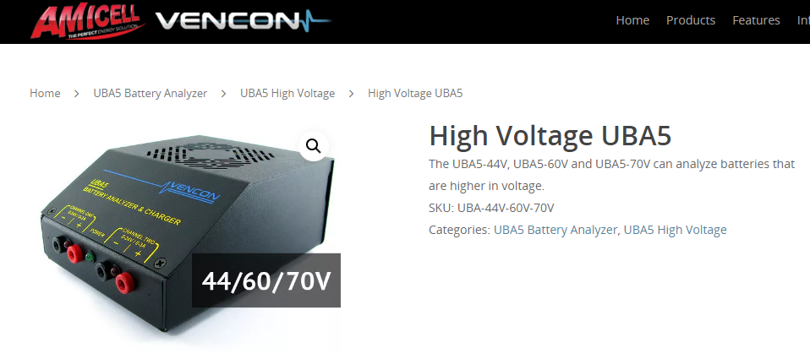
Battery Tester
https://www.vencon.com/product/high-voltage-uba5-battery-analyzer/
Programmable tester (can program charge and discharge profiles that we need)
We will likely need the “high voltage” versions, since the nominal pack voltage is ~23V and we are interested in testing the entire pack and not individual cells.

